Slide 2
Online Tutorial : Number Three
Session Three: Logic
  Propositions, Symbolic Statements and Truth Tables
  Conditional Connectives
  Laws of Logic
  Logic Gates

Slide 3
Symbolic Statements and Truth Tables (3.1)
Learning Objectives
After studying this section, you should be able to;
define the truth set of a given proposition;
recognise when a given proposition is a tautology or a contradiction;
state the negation of a given proposition;
construct the truth table for the connectives not, and, or and exclusive or.

Slide 4
Logic: Symbolic Statements and Truth Tables
  Propositions (Section 3.1.1)
  Tautologies and Contradictions
  Tautologies : Propositions that are always true
  Contradictions : Propositions that are always false
  (Remark : Truth sets for contradictions are always empty sets)

Slide 5
Negations and Compound Statements (3.1)
  Negation of a proposition (3.1.2)
    NOT
  Compound statements for propositions p and q(3.1.3)
    AND (symbol : Wedge)
    OR (symbol : Vee)
    XOR (symbol : otimes)
  Truth Tables and Truth Sets

Slide 6
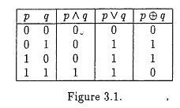
Compound Statements : Truth Tables

Slide 7
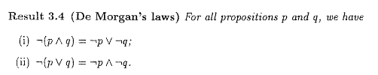

De Morgan’s Laws

Slide 8
Logic: Symbolic Statements and Truth Tables
  (2008 Q3a)
  Let p and q be the following propositions about an object
    p: “ this objects is a triangle”
    q: “ this object is blue”
  Express each of the following compound propositions symbolically by using p, q and appropriate logic symbols
    This object is a blue triangle
    If this object is blue, then it is a triangle
    This object is not blue, but it is a triangle.

Slide 9
Logic: The Contrapositive
  (From previous question, 2008 Question 3)
  Write in words the contra-positive of the statement given symbolically as “q → p” .
  (i.e. If the object is blue then it is a triangle.)
    ¬p: “ this objects is not a triangle”
    ¬q: “ this object is not blue”

Slide 10
Logic: The Conditional Connectives
  The Conditional Connectives
  The Conditional Connectives are
    If
    Only If / Implies (p → q)
    If and Only If (p ↔ q)
  Truth Tables
  The Contra-Positive (approach using truth tables)

Slide 11
Truth Table Exercise
p | q | p → q | q→ p | (p → q) V (q → p) | p ↔ q
0 | 0 | 1 | 1 |  | 1
0 | 1 | 1 | 0 |  | 0
1 | 0 | 0 | 1 |  | 0
1 | 1 | 1 | 1 |  | 1

Slide 12
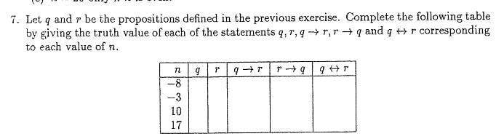
End of Chapter Question 7

Slide 13
End of Chapter Question 7
n | q | r | q → r | r→ q | q ↔ r
-8 | 1 | 0 | 0 | 1 | 0
-3 | 0 | 0 | 1 | 1 | 1
10 | 1 | 1 | 1 | 1 | 1
17 | 0 | 1 | 1 | 0 | 0

Slide 14
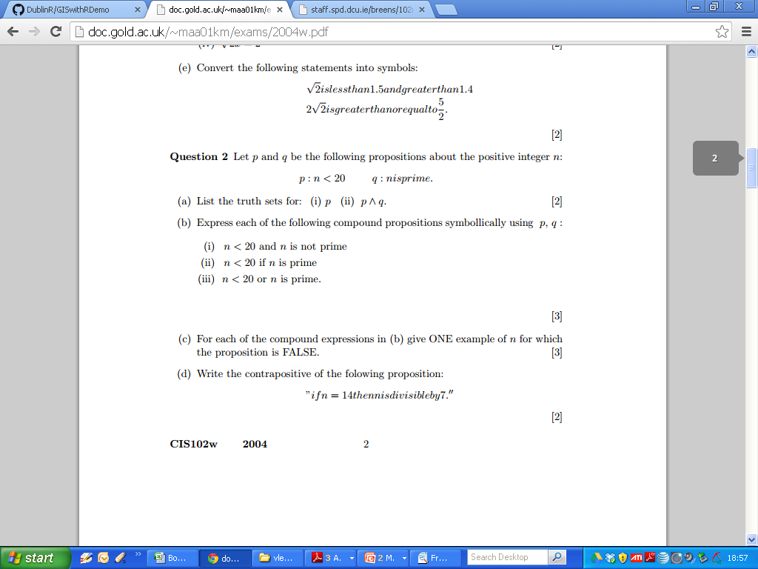
2004 Question 2

Slide 15
2004 Question 2

Slide 16
2004 Question 2

Slide 17
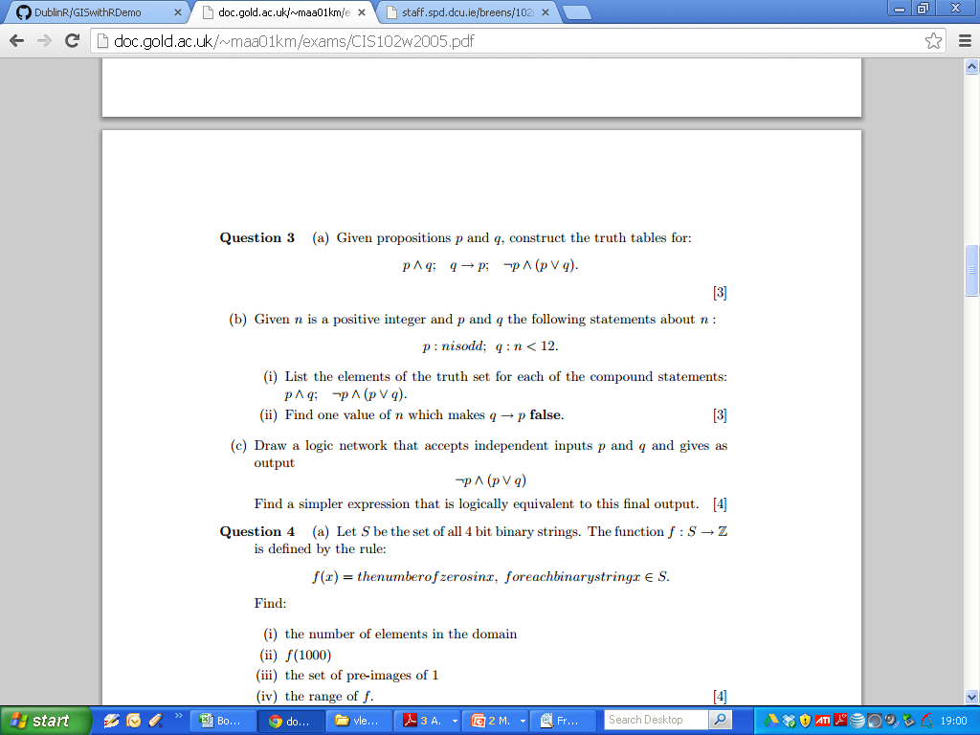
2005 Q3

Slide 18
2005 Q 3

Slide 19
2005 Q3

Slide 20
Logic: The Laws of Logic
  The Laws of Logic
  The Commutative Laws
  The Associative Laws
  Distributive Laws
  De Morgan’s Laws
  Identity Laws
  Asborption and Complement Laws

Slide 21
Logic: The Laws of Logic : Membership Tables
p | q | ¬p | ¬q | p∧q (“AND”) | p∨ q (“OR”) | p → q | p ↔ q | p ⊕q (“XOR”)
0 | 0
0 | 1
1 | 0
1 | 1

Slide 22
Logic: The Laws of Logic : Membership Tables
p | q | ¬p | ¬q | p∧q (“AND”) | p∨ q (“OR”) | p → q | p ↔ q | p ⊕q
0 | 0 | 1 | 1 | 0 | 0 | 1 | 1 | 0
0 | 1 | 1 | 0 | 0 | 1 | 1 | 0 | 1
1 | 0 | 0 | 1 | 0 | 1 | 0 | 0 | 1
1 | 1 | 0 | 0 | 1 | 1 | 1 | 1 | 0

Slide 23
Logic: The Laws of Logic
  (2012 Zone B Question 2 c) Use Truth Tables to prove that:
  (p∧q) ∨ (¬p ∧ ¬q) ≡ p ↔ q
p | q | p∧q | ¬p | ¬q | (¬p ∧ ¬q) | (p∧q) ∨ (¬p ∧ ¬q) | p ↔ q
0 | 0 |  | 1 | 1 |  |  | 1
0 | 1 |  | 1 | 0 |  |  | 0
1 | 0 |  | 0 | 1 |  |  | 0
1 | 1 |  | 0 | 0 |  |  | 1

Slide 24
Logic: The Laws of Logic (Answer)
  (2012 Zone B Question 2 c) Use Truth Tables to prove that:
  (p∧q) ∨ (¬p ∧ ¬q) ≡ p ↔ q
p | q | p∧q | ¬p | ¬q | (¬p ∧ ¬q) | (p∧q) ∨ (¬p ∧ ¬q) | p ↔ q
0 | 0 | 0 | 1 | 1 | 1 | 1 | 1
0 | 1 | 0 | 1 | 0 | 0 | 0 | 0
1 | 0 | 0 | 0 | 1 | 0 | 0 | 0
1 | 1 | 1 | 0 | 0 | 0 | 1 | 1

Slide 25
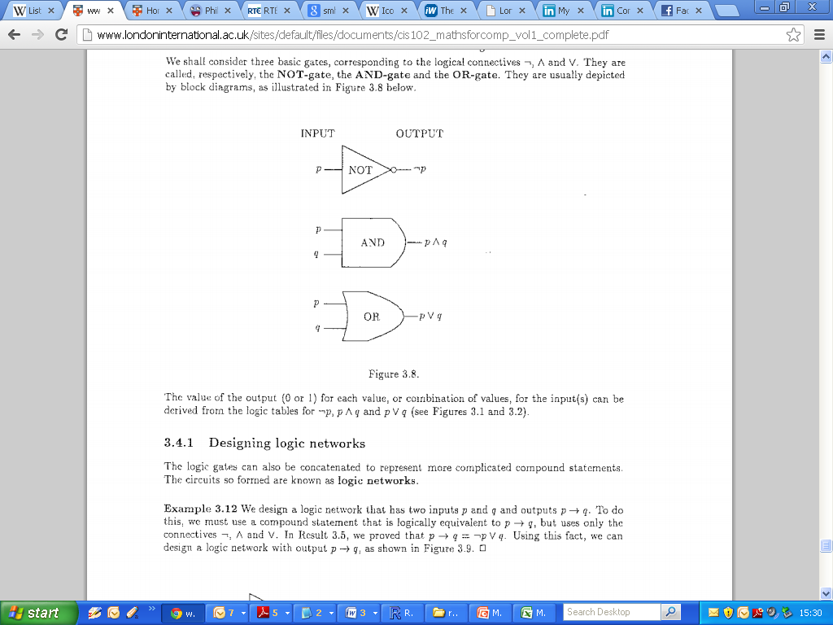
Logic: Logic Gates
  Designing Logic Gates
  Output of a given Network

Slide 26
Logic: Logic Gates
  (2008 Q3b)
  Construct a logic network that accepts as inputs p and q, which may independently have value 0 or 1, and give as final output ¬(p ∧ ¬q) .
  Show that this expression is equivalent to p → q. (i.e. using truth tables)

Slide 27
Logic: Logic Gates

Slide 28
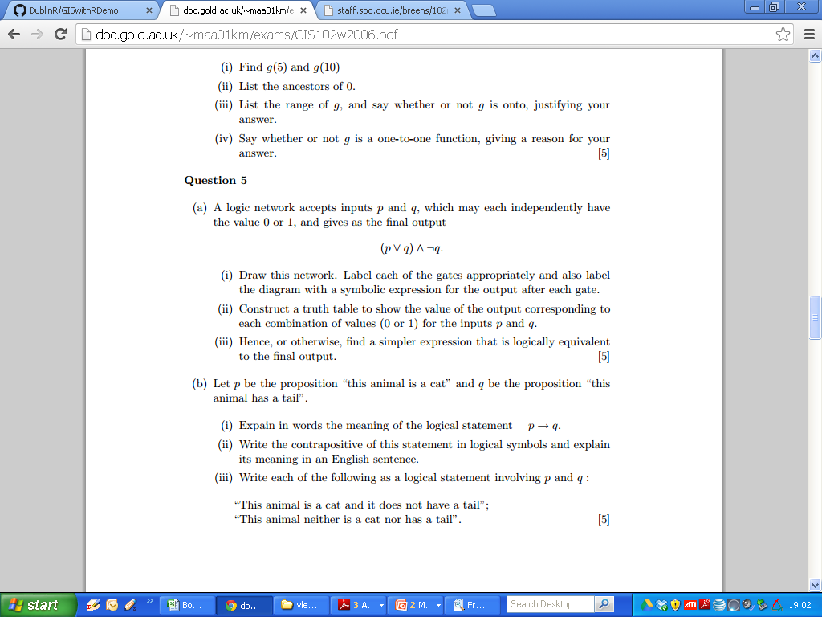
2006

Slide 29
2006

Slide 30
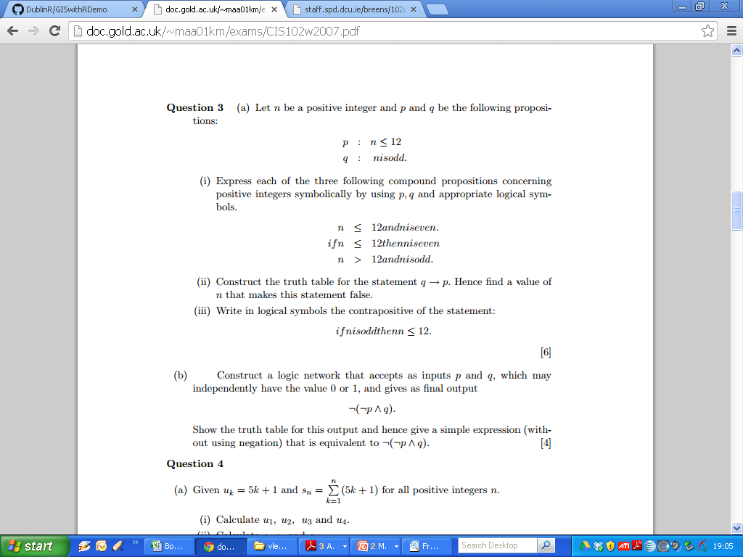
2007

Slide 31
2007

